Slide 1
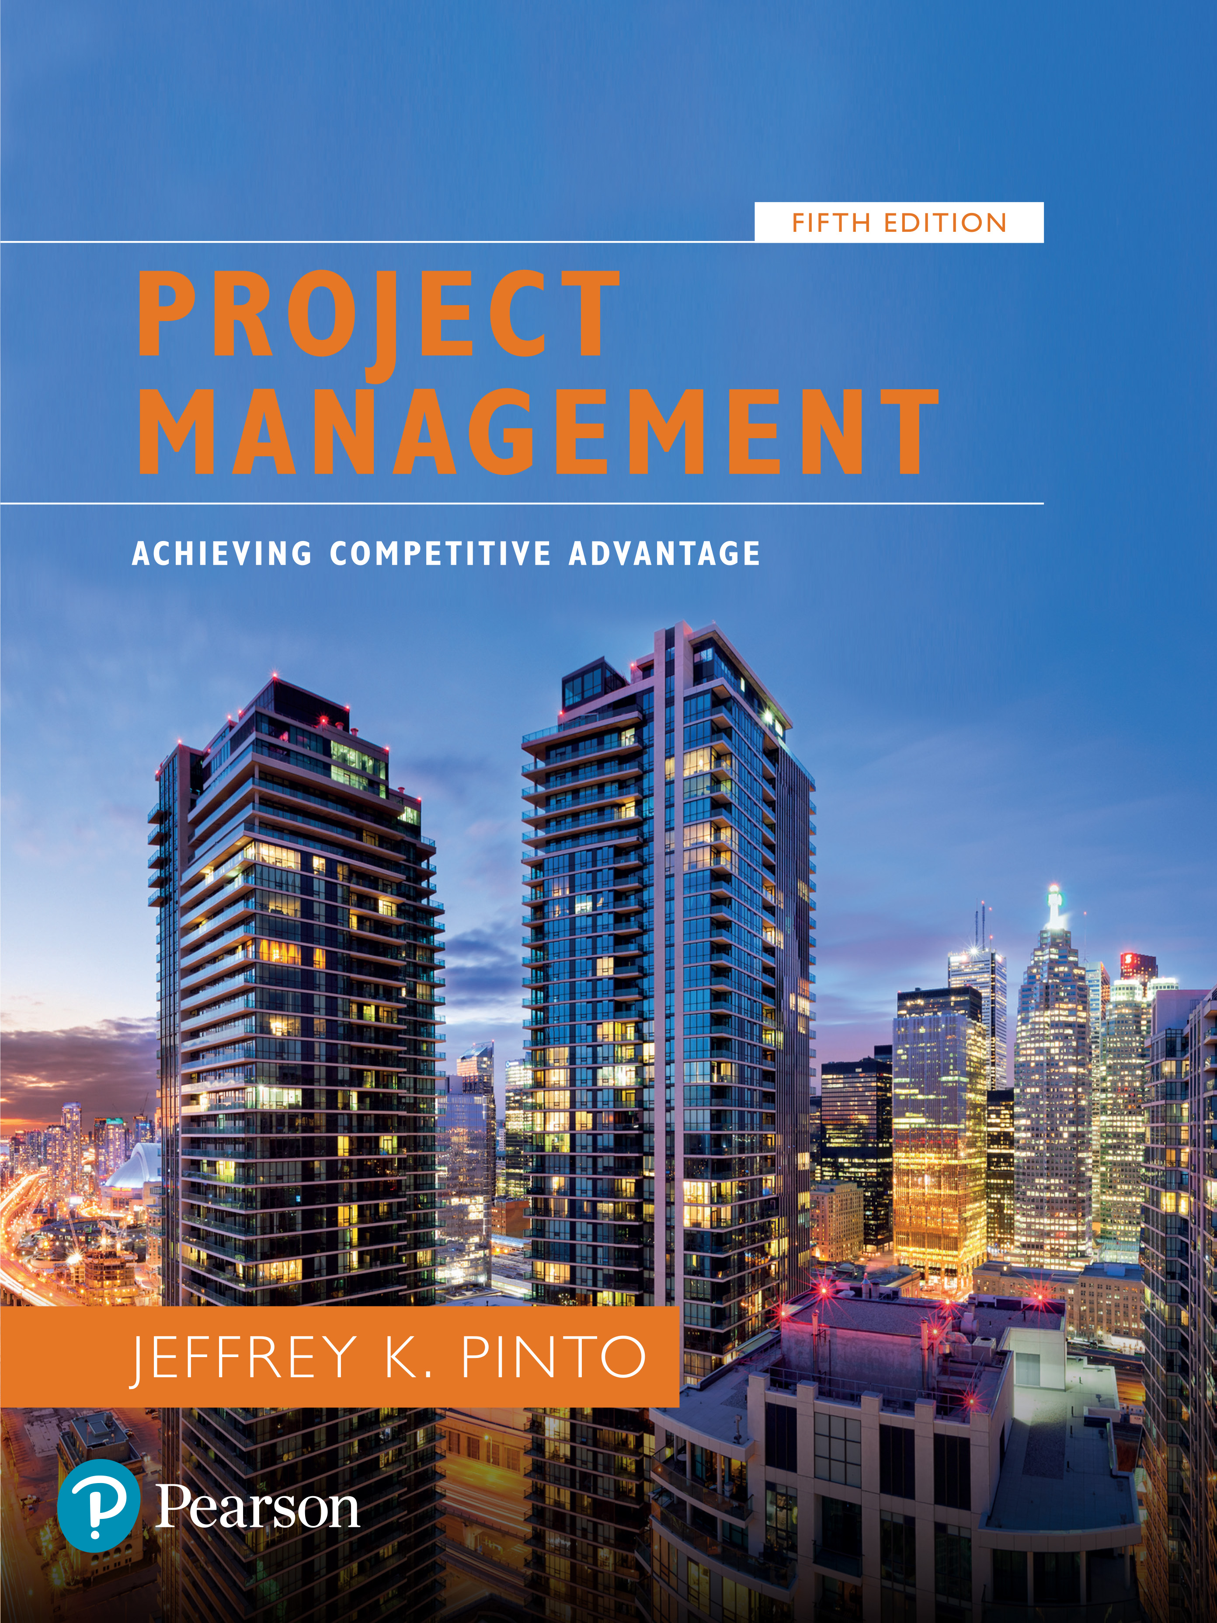
Project Management: Achieving Competitive Advantage
Fifth Edition
Chapter 4
Leadership and the Project Manager
Copyright © 2019, 2016, 2013 Pearson Education, Inc. All Rights Reserved
Notes:
If this PowerPoint presentation contains mathematical equations, you may need to check that your computer has the following installed:
1) MathType Plugin
2) Math Player (free versions available)
3) NVDA Reader (free versions available)

Slide 2
Learning Objectives (1 of 2)
4.1 Understand how project management is a “leader-intensive” profession.
4.2 Distinguish between the role of a manager and the characteristics of a leader.
4.3 Understand the key behaviors in which project leaders engage to support their projects.
4.4 Recognize traits that are strongly linked to effective project leadership.

Slide 3
Leadership
“The ability to inspire confidence and support among the people who are needed to achieve organizational goals.”
Project management is leader intensive!

Slide 4
Leaders And Partnership
Exchange of purpose
A right to say no
Joint accountability
Absolute honesty

Slide 5
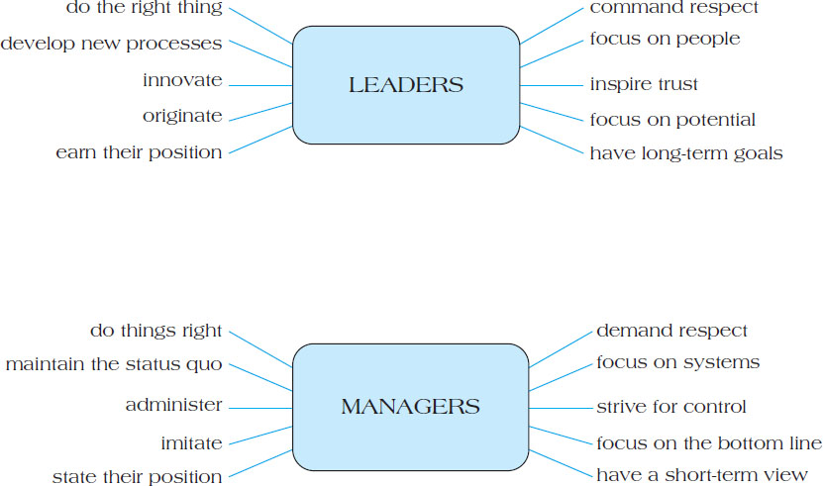
Figure 4.2 Differences Between Managers and Leaders

Slide 6
How the Project Manager Leads
Project managers function as mini-C E O s and manage both “hard” technical details and “soft” people issues.
Project managers:
1. Acquire project resources: Project are underfunded for a variety of reasons:
Vague goals, Lack of top management support, Requirements understated, Insufficient funds and Distrust between managers

Slide 7
Contd.
2. Motivate and build teams
3. Have a vision and fight fires
4. Communicate

Slide 8
Communication
Define project and team players.
Provide an opportunity to revise, update, and add to knowledge base.
Assist team members in understanding role in project as part of whole and how to contribute to project success.
Help stakeholders increase commitment to project.
Provide a collective opportunity to discuss project.
Provide visibility for project manager’s role.

Slide 9
Communication (1 of 2)
It is critical for a project manager to maintain strong contact with all stakeholders.
Project meetings feature task-oriented and group maintenance behaviors.
Table 4.1 Task and Group Maintenance Behaviors for Project Meetings
Task-Oriented Behavior | Specific Outcome
1. Structuring process | Guide and sequence discussion
2. Stimulating communication | Increase information exchange
3. Clarifying communication | Increase comprehension
4. Summarizing | Check on understanding and assess progress
5. Testing consensus | Check on agreement

Slide 10
Communication (2 of 2)
Table 4.1 [continued]
Group Maintenance Behavior | Specific Outcome
1. Gatekeeping | Increase and equalize participation
2. Harmonizing | Reduce tension and hostility
3. Supporting | Prevent withdrawal, encourage exchange
4. Setting standards | Regulate behavior
5. Analyzing process | Discover and resolve process problems

Slide 11
Characteristics of an Effective Project Manager
Leads by example
Visionary
Technically competent
Decisive
A good communicator
A good motivator
Stands up to top management when necessary
Supports team members
Encourages new ideas

Slide 12
Characteristics of Project Managers Who Are Not Leaders
Personal Flaw
Sets bad example
Not self-assured
Lacks technical expertise
Poor communicator
Poor motivator
Organizational Factors
Lack of top management support
Resistance to change
Inconsistent reward system
A reactive organization rather than a proactive, planning one
Lack of resources

Slide 13
Leadership and Emotional Intelligence
Emotional intelligence refers to leaders’ ability to understand that effective leadership is part of the emotional and relational transaction between subordinates and themselves.
Five elements characterize emotional intelligence:
Self-awareness
Self-regulation
Motivation
Empathy
Social skills

Slide 14
Traits of Effective Project Leaders
One study on effective project leadership revealed these common characteristics:
Credibility
Creative problem-solver
Tolerance for ambiguity
Flexible management style
Effective communication skills

Slide 15
Essential Project Management Abilities
Organizing under conflict
Experience
Decision making
Productive creativity
Organizing with cooperation
Cooperative leadership
Integrative thinking

Slide 16
Who Are Project Champions?
Champions are “fanatics” in the single-minded pursuit of their pet ideas.
They are individuals within an organization who identify with new developments and use all the resources available to them to pursue that development irrespective of any resistance within the organization.

Slide 17
Contd.
Champions can be:
creative originator
entrepreneur
“godfather” or sponsor
project manager

Slide 18
Champion Roles
Traditional Duties
Technical understanding
Leadership
Coordination and control
Obtaining resources
Administrative
Nontraditional Duties
Cheerleader
Visionary
Politician
Risk-taker
Ambassador

Slide 19
Creating Project Champions
Identify and encourage their emergence.
Encourage and reward risk takers.
Remember the emotional connection.
Free champions from traditional project management duties.

Slide 20
New Project Leadership
Four competencies determine a project leader’s success:
Understand and practice the power of appreciation.
Remind people what’s important.
Generate and sustain trust.
Align with the leader.

Slide 21
Right Management Choices in International Setting
Develop a detailed understanding of the environment.
Do not stereotype.
Be genuinely interested in cultural differences.
Do not assume there is one way (yours) to communicate.
Listen actively and empathetically.

Slide 22
Project Management Professionalism
Project work is becoming the standard for many organizations.
There is a critical need to upgrade the skills of current project workers.
Project managers and support personnel need dedicated career paths.

Slide 23
Creating Project Managers
Match personalities with project work.
Formalize commitment to project work with training programs.
Develop a unique reward system.
Identify a distinct career path.

Slide 24
P M I Code of Ethics
The Project Management Institute’s code of ethics for project managers consists of:
Responsibility
Respect
Fairness
Honesty

Slide 25
Normative Versuse Behavioral Ethics
Normative ethics: What will a person or organization do in a given situation?
Behavioral ethics: Why do people behave the way they do in the workplace?
Table 4.5 Normative Ethics and Project Manager Behaviors
Orientation | Category | Project Manager’s Responsibility
Process | Deontological ethics explains the rules, maxims, norms, and principles to govern conduct. Moral obligations concerning justice and fairness. Social contract theories. | Make sure processes are just, fair, and reasonable and do not violate human rights.
Outcome | Consequentialism defines right conduct in terms of the alternative likely to produce the best overall outcome for the stakeholders. | Maximize the overall value for the stakeholders.
Character | Virtue ethics focuses on the moral virtues of honesty, integrity, fairness, courage, care, and how they are developed and nurtured. | Exhibit exemplary personal conduct that serves as a model for others of how to act.

Slide 26
Unethical Behaviors
Corruption is the abuse of entrusted power for private gain.
Petty corruption: everyday abuse of power by low-level officials with ordinary citizens.
Grand corruption: committed by relevant institutions such as governments, corporations, or legal bodies.

Slide 27
Types of Corruption
Common types of corruption include:
Bribery
Extortion
Fraud
Abuse of Power
Embezzlement
Conflict of Interest
Nepotism

Slide 28
Summary (1 of 2)
Understand how project management is a “leader-intensive” profession.
Distinguish between the role of a manager and the characteristics of a leader.
Understand the key behaviors in which project leaders engage to support their projects.
Recognize traits that are strongly linked to effective project leadership.

Slide 29
Summary (2 of 2)
Identify the key roles project champions play in project success.
Recognize the principles that typify the new project leadership.
Understand the development of project management professionalism in the discipline.
Recognize the important role ethics plays for successful project leadership.

Slide 30
Thanks

